Slide 1
INTELLIGENT GARBAGE CLASSIFICATION USING DEEP LEARNING
AIML Fundamentals with Cloud Computing and Gen AI (Capstone Project)
Name :K.SRIRAM
NM-ID :au810021114317
E-mail :sriram2002116@gmail.com
Guided By :P.RAJA (MASTER DEGREE)

Slide 2

OUTLINE
Abstract of the project
Problem Statement
Proposed Solution
System architecture
GitHub Link
Project Demo(photos / videos)
Conclusion
Future Scope
References

Slide 3

ABSTRACT
The growing concern over waste management and environmental sustainability has necessitated the development of efficient and automated systems for garbage classification. Traditional methods are labor-intensive and prone to error, making the need for intelligent solutions more urgent. This paper presents a deep learning-based approach for intelligent garbage classification, leveraging convolutional neural networks (CNNs) to accurately categorize waste into different classes such as plastic, paper, metal, and organic. Theproposesystem utilizes a large dataset of labeled garbage images to train the model, achieving high accuracy in distinguishing between various waste types. Key challenges addressed include data preprocessing, model optimization, and ensuring generalization across diverse real-world environments. The results demonstrate that the deep learning model outperforms conventional classification methods in terms of accuracy, efficiency, and scalability. The proposed solution has the potential to revolutionize waste management systems, enabling automated recycling and reducing the environmental impact of improper waste disposal.

Slide 4

Problem Statement
Introduction: Waste management is a critical issue in urban areas, with improper waste disposal leading to environmental pollution and health hazards. Manual segregation of waste is inefficient, time-consuming, and prone to errors. To address this challenge, there is a need for an intelligent system that can automatically classify and segregate waste materials based on their type for proper disposal or recycling. Problem: The current methods of waste management largely depend on human intervention for waste sorting, which is: - Time-consuming - Prone to errors - Labor-intensive - Inconsistent in terms of classification accuracy **Objective:** To develop an intelligent garbage classification system using deep learning techniques that can: - Automatically identify and classify various types of waste (e.g., plastic, paper, metal, organic, etc.) - Improve the accuracy and speed of waste segregation - Reduce human effort and errors - Contribute to more sustainable and efficient recycling processes **Challenges:** - Variability in waste types (e.g., different shapes, sizes, and materials) - Need for a large, diverse dataset for training the model - Real-time processing requirements for deployment in waste management systems **Solution Approach:** - Leverage deep learning models (e.g., Convolutional Neural Networks - CNNs) for image recognition and classification tasks. - Train the model using labeled datasets of images representing various waste types. - Deploy the trained model in smart waste bins or robotic systems for automatic waste segregation. By addressing these challenges, intelligent garbage classification can lead to a more efficient and environmentally friendly waste management system.

Slide 5
Proposed Solution
An intelligent garbage classification system using deep learning can be implemented by using Convolutional Neural Networks (CNNs) to classify waste items into categories (e.g., plastic, paper, metal, organic, etc.) based on images. The proposed solution involves the following steps: Data Collection: Gather a large dataset of labeled images of different types of garbage from various sources. Preprocessing: Clean and preprocess the images by resizing, normalizing, and augmenting them to enhance the model's robustness. Model Design: Use a CNN architecture (e.g., ResNet, Inception, or MobileNet) to learn features from the images and classify them into appropriate categories. Training: Train the model using a labeled dataset, applying techniques like transfer learning, data augmentation, and regularization to improve accuracy and generalization. Deployment: Implement the model on edge devices like smartphones or waste sorting robots, enabling real-time garbage classification. Continuous Improvement: Update the model with new data and retrain periodically to adapt to new types of waste and improve performance. This solution leverages deep learning's power to automate waste sorting, increasing recycling efficiency and promoting environmental sustainability.

Slide 6
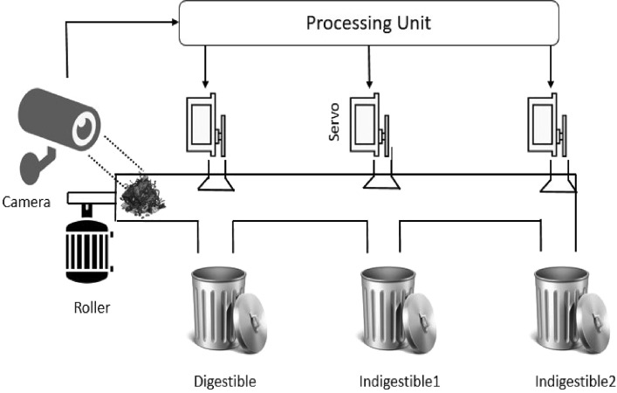
System architecture

Slide 7
STEP-BY-STEP PROCESSING :
A processing unit, typically called a **CPU** (Central Processing Unit), is the primary component of a computer responsible for executing instructions.
A **servo** (short for "servomechanism") is a type of motor that is used to control the position, speed, or torque of a mechanical system.
A camera is a device used to capture images or videos. It works by using a lens to focus light from a scene onto a sensor or film, which then records the image.
A roller is a cylindrical tool or machine used for various purposes. In construction, it's used to compact soil, asphalt, or gravel. In printing, a roller applies ink to the surface.
Digestible" refers to something that is easy to understand or process. It can apply to food (something that can be broken down by the body) or information (something that is easy to comprehend)

Slide 8
GitHub Link
https://github.com/sriramkamarajan/sriram.k/blob/main/Waste_Garbage_Collection_improve.ipynb

Slide 9
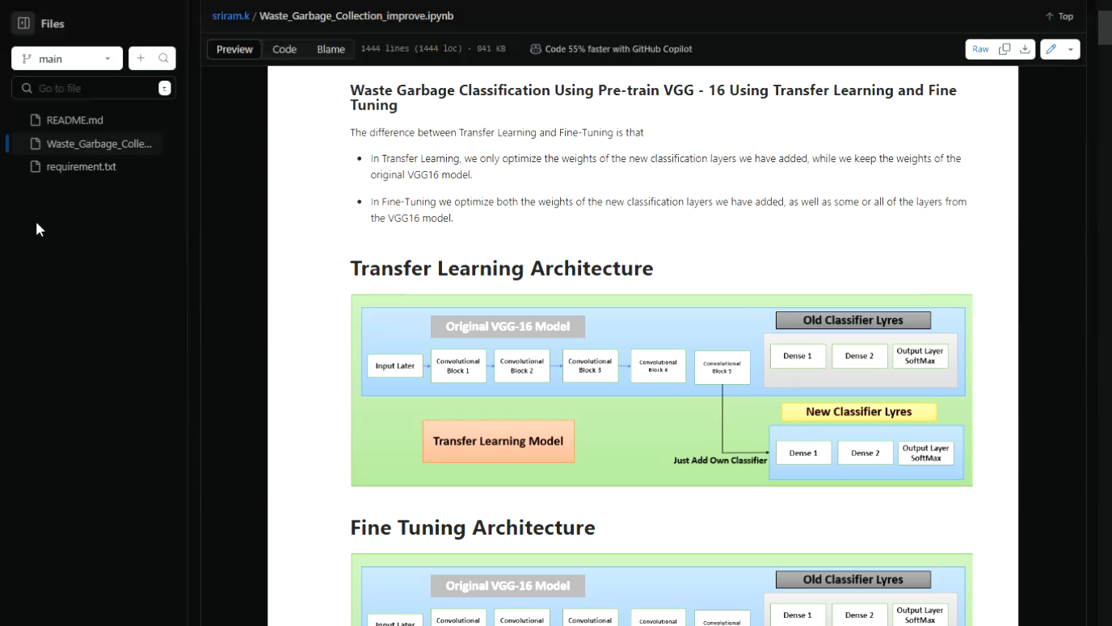
Project Demo(Recorded Video)

Slide 10
Conclusion
In conclusion, intelligent garbage classification using deep learning represents a significant advancement in waste management technology. By leveraging deep learning models, such as convolutional neural networks (CNNs), to automatically classify and sort waste materials, we can greatly enhance recycling efficiency, reduce environmental pollution, and improve sustainability efforts. These models can process large datasets of images or sensor data to accurately identify different types of waste, such as plastics, metals, paper, and organic matter. With continuous improvements in model accuracy, computational power, and the availability of labeled data, deep learning-driven garbage classification systems have the potential to revolutionize waste management practices, leading to cleaner cities, reduced landfill waste, and a more sustainable future. However, challenges such as model generalization, real-time processing, and integration into existing waste management infrastructure need to be addressed for widespread adoption.

Slide 11
Future Scope
The future scope of intelligent garbage classification using deep learning is promising. As waste management becomes increasingly crucial, deep learning models can significantly enhance recycling efficiency by automating the sorting process. By using computer vision and advanced neural networks, these systems can accurately classify waste into categories like plastic, metal, organic, and non-recyclables. This will not only reduce human error and labor costs but also optimize recycling rates and contribute to environmental sustainability. Future advancements could involve integrating Internet of Things (IoT) sensors, real-time data analytics, and edge computing to create more efficient, scalable, and autonomous waste management systems.

Slide 12
References
Project Github link, https://github.com/sriramkamarajan/sriram.k/blob/main/Waste_Garbage_Collection_improve.ipynb
Project video recorded link (youtube/github)-https://youtu.be/miM0rLjeChc?si=aQg3QHFqag-Hrp4e
Project PPT & Report github link
https://github.com/sriramkamarajan/sriram.k/blob/main/Waste_Garbage_Collection_improve.ipynb

Slide 13
THANK YOU

